Slide 1
RHS FOOTPEG HOLDER
for a supersport bike
Prof.
Massimiliano De Agostinis
A Chassis and Body Design and Manifacturing M project by
Luca Zappalorti
Università di Bologna
Dipartimento di Ingegneria Industriale
A.A. 2022/2023

Slide 2
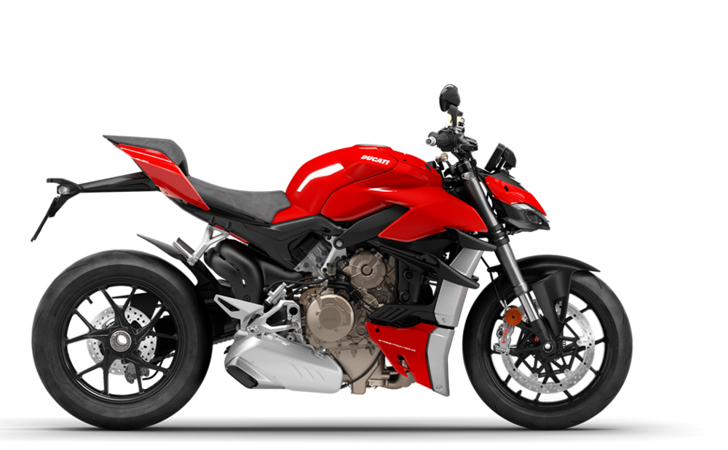
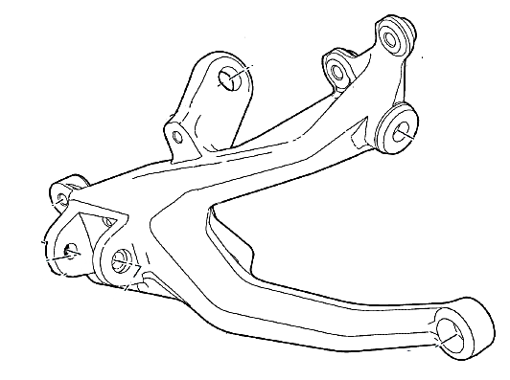
Chassis and Body Design
and Manifacturing M
RIGHT SIDE
FOOTPEG HOLDER
PROJECT 4
for a supersport bike
1
Project Assignment
Right Side Footpeg Holder
Design and validation of the footpeg support and mounting screws for Ducati Streetfighter

Slide 3
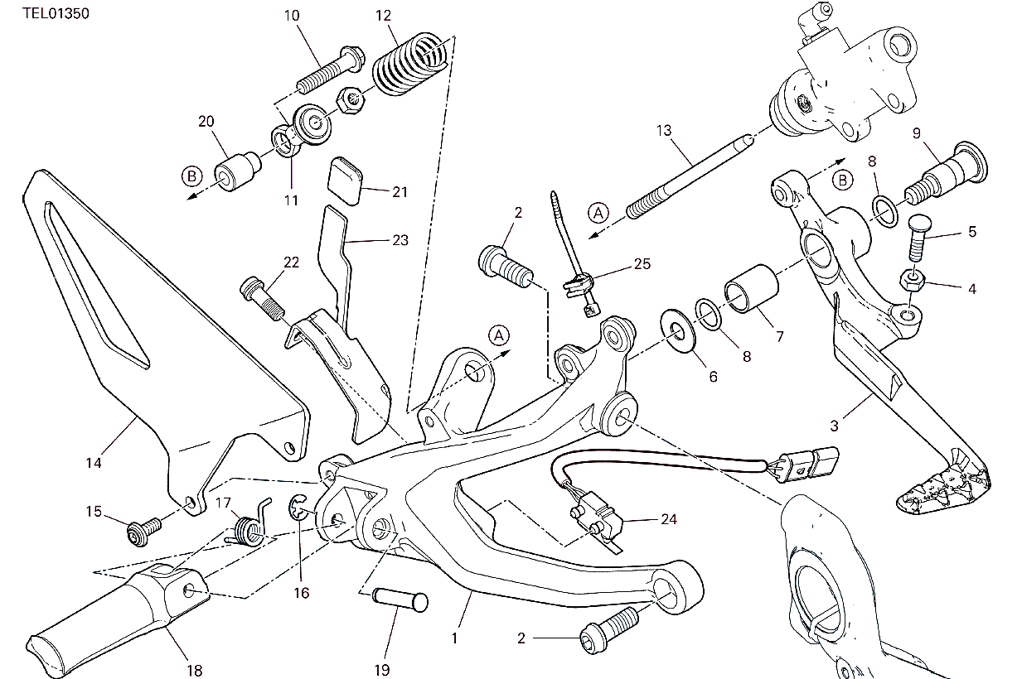
Chassis and Body Design
and Manifacturing M
RIGHT SIDE
FOOTPEG HOLDER
PROJECT 4
for a supersport bike
1
Project Assignment
Ducati Streetfighter Solution
List of the main components of the Ducati solution that we will use for our schematic representation of the problem.
(1) Footpeg Holder Plate
(2) TCEIF Screws
(3) Brake pedal
(11) Joint
(13) Brake Pump Shaft
(18) Footpeg
Notes:
The project assignment is to design and validate the footpeg holder and mounting screws for Ducati Streetfighter​

Slide 4
Chassis and Body Design
and Manifacturing M
RIGHT SIDE
FOOTPEG HOLDER
PROJECT 4
for a supersport bike
2
Material Properties
Mechanical properties best trade-off
Scalmalloy ® has the 2nd greatest Yield Strength (Sy) and the 3rd best Elongation at break (E%)
Source: Totalmateria, APWORKS
Notes:
Material assigned was AM aluminium alloy. We performed a deep research in TotalMateria database in terms of Yeld Strength, Ultimate Tensile Strength and Brake Elongation and we represented the top ten materials according to this parameters. This is the reason why, we chose the Scalmalloy, which is a good tradeoff between these different properties.​ Good trade trade off Sy, UTS, E%​

Slide 5
Chassis and Body Design
and Manifacturing M
RIGHT SIDE
FOOTPEG HOLDER
PROJECT 4
for a supersport bike
2
Material Properties
strain rate: 10⁻³/s
Data | Chemical Composition | Al | Mg | Sc | Zr | Mn
 |  | ≈93 | 4,6 | 0,66 | 0,42 | 0,49
 | Type | Additive Manufacturing Aluminium
 | Commercial Name | Scalmalloy®
 | Yield Strength | 470 MPa
 | Tensile Strength | 520 MPa
 | Elongation | 13%
 | Young’s Modulus | 70 GPa
 | Density | 2,67 kg/dm³
 | Vickers Hardness | 180 HV
 | Supply Condition | Heat treated and machined
 | Manufacturer | AIRBUS APWORKS Gmbh
 | Price | 4.000 – 6.000 €/kg
500
Heat-treated
400
As-is
300
Nominal stress [MPa]
200
100
0
0
0,05
0,1
0,15
0,2
0,25
0,3
Nominal strain [-]
Source: Totalmateria, apworks
Notes:
In this table, you can see different material properties of this aluminium alloy and in the right picture you can see Stress-Strain curve in two different supply conditions.​

Slide 6
Chassis and Body Design
and Manifacturing M
RIGHT SIDE
FOOTPEG HOLDER
PROJECT 4
for a supersport bike
2
Material Properties
550
500
450
Microstructure
Ultimate tensile strength [MPa]
heat treated
as-is
Due to the high cooling rates and rapid solidification, a unique microstructure is achieved
Lightweight, corrosion resistant and with high ductility
400
350
100
10⁻³
10⁻²
10⁻¹
10⁰
10¹
10²
10³
Topological Optimization
Nominal strain rate [1/s]
Coupling these material properties with the design freedom provided by AM processes can enable high performance parts with a level of functionality previously impossible to achieve.
10⁻³
10⁻²
10⁻¹
10⁰
10¹
10²
10³
0,3
0,25
Applications
0,2
Nominal failure strain [-]
Wide range of highly loaded functional applications in aerospace, motorsport, automotive and robotics
heat treated
as-is
0,15
Source: Totalmateria, apworks
0,1
Notes:
Here we can appreciate the Key properties of Scalmalloy. It is Lightweight, corrosion resistant with an high ductility and is likely to be produced very well with Additive Manufacturing technique. Due to that, it has many different applications in aerospace, motorsport, automotive and so on ….​

Slide 7
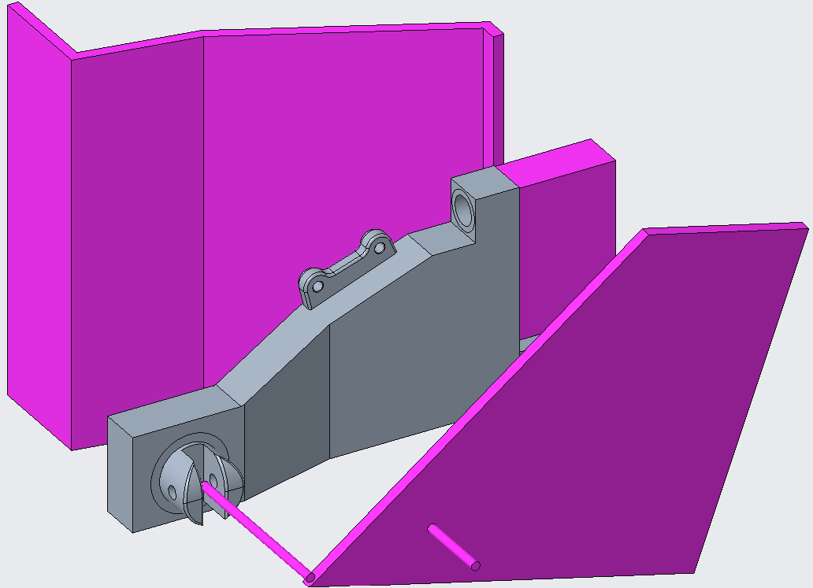
Chassis and Body Design
and Manifacturing M
RIGHT SIDE
FOOTPEG HOLDER
PROJECT 4
for a supersport bike
3
Structural Analysis
2D General Hypothesis
Initial assigned loads Fz1 and Fz2
Geometric references imposed as initial constraints
Holder and brake lever developed in the plane;
All loads are acting in the same plane;
No bending moment derived from Fz1 and Fz2 transportations in the transversal direction;
Brake pedal at end stop;
The holder is understood as a V-shaped beam;
The brake leverage is developed as a system of rods;
The pump mounts are schematised as one.
Fz1
Fz2
15 mm
Notes:
I'm going to introduce you our starting 2D Hypotesis (assignment loads Fz1,Fz2 and violet-painted geometrical constraints). We made a huge series of hypotesis. ​

Slide 8
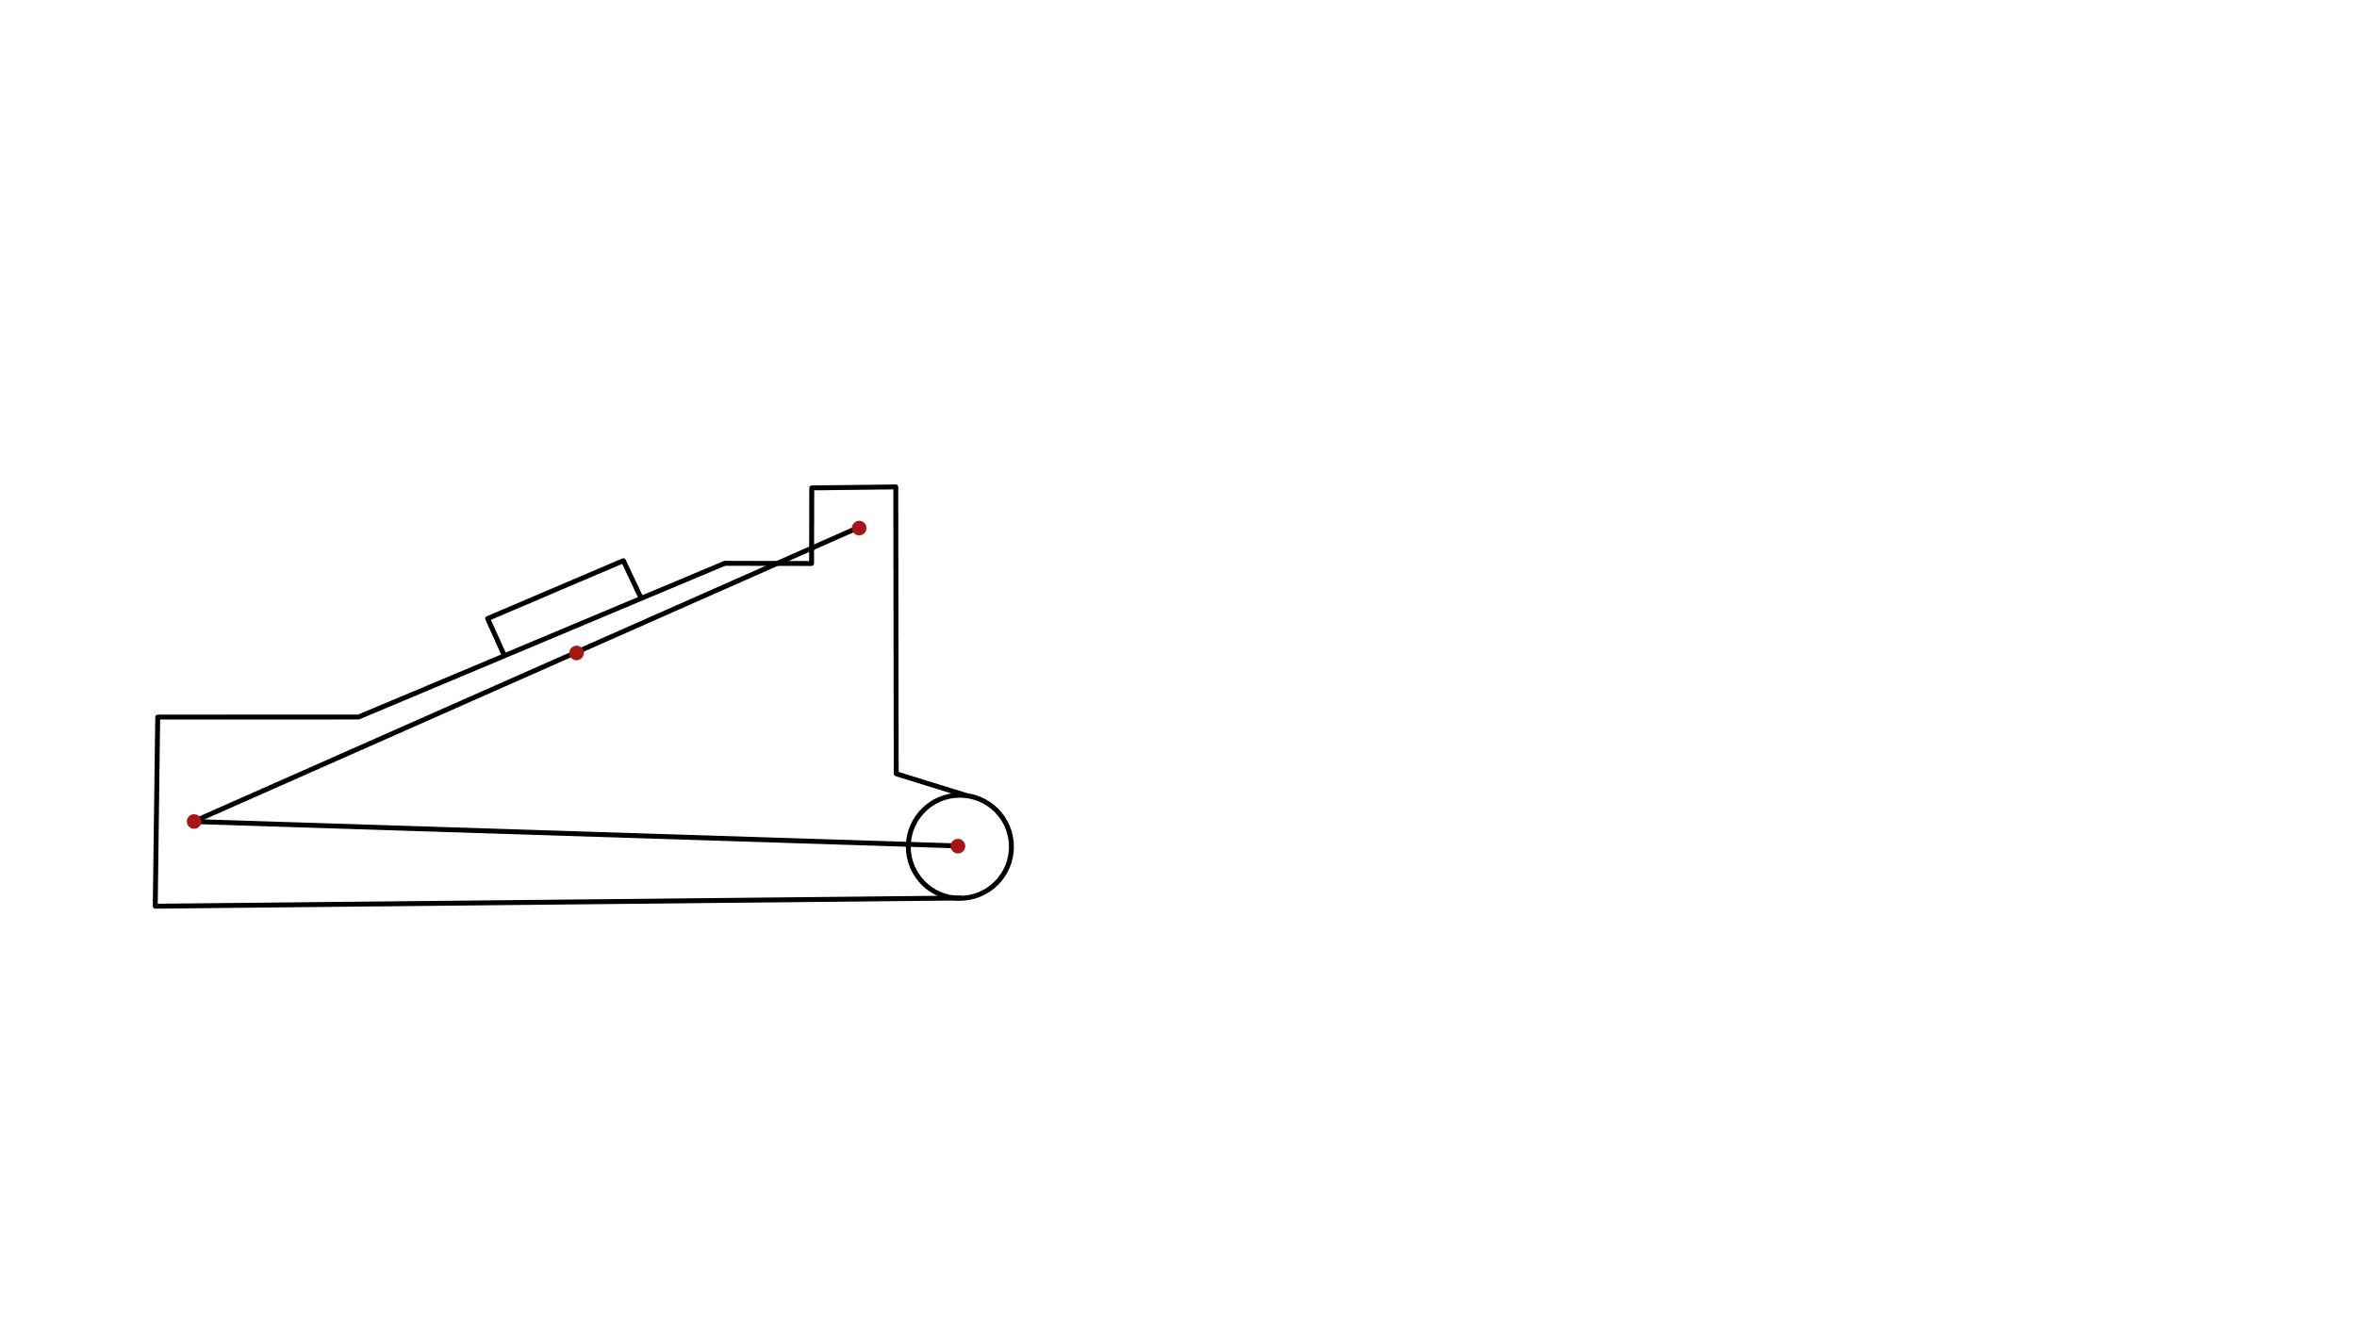
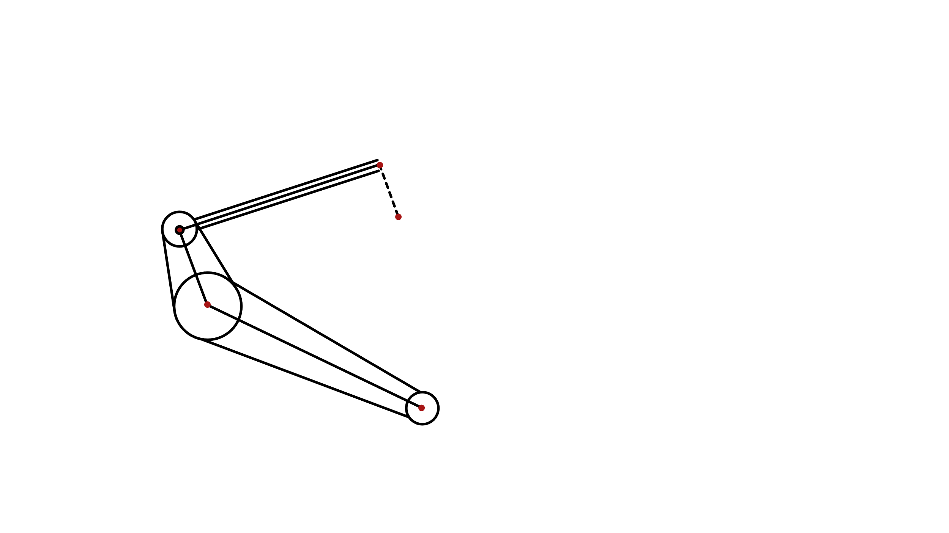
Chassis and Body Design
and Manifacturing M
RIGHT SIDE
FOOTPEG HOLDER
PROJECT 4
for a supersport bike
3
Structural Analysis
2D General Hypothesis
Internal hinge joint
To brake pump
Initial assigned loads Fz1 and Fz2
Geometric references imposed as initial constrains
Holder and brake lever developed in the plane;
All loads are acting in the same plane;
No bending moment derived from Fz1 and Fz2 transportations in the transversal direction;
Brake pedal at end stop;
The holder is understood as a V-shaped beam;
The brake leverage is developed as a system of rods;
The pump mounts are schematised as one.
D'
Brake pump rod
Upper screw
B
E'
D
Holder plate
Brake lever
A
C'≣C
Lower screw
Central hinge
(pin-footpeg axis)
A'
Brake pedal
Notes:
Thus this is our schematisation. ​

Slide 9
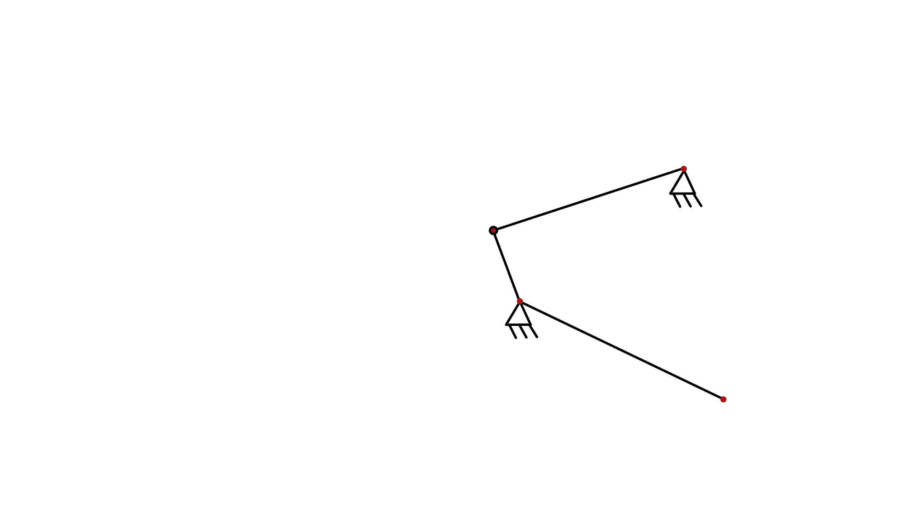
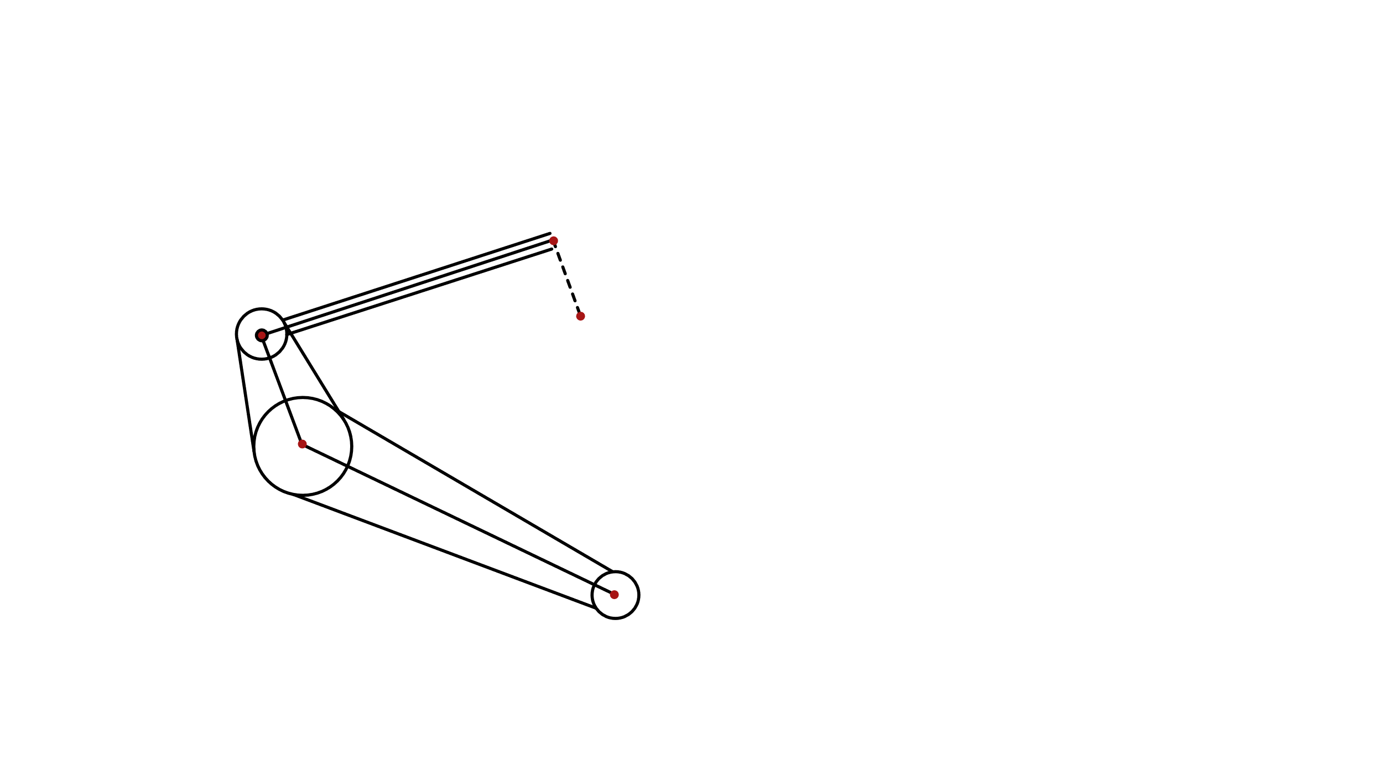

Chassis and Body Design
and Manifacturing M
RIGHT SIDE
FOOTPEG HOLDER
PROJECT 4
for a supersport bike
3
Structural Analysis
xD'
D'
Constraint reactions
E'
D
Let's calculate the reactions: they will be part of the external loads of the footpeg holder plate.
y_{C’} = 875 N
x_{C’} = 1.270 N
y_{D’} = -375 N
x_{D’} = -1.270 N
yD'
y
xC'
x
C'
Fz₂
yC'
A'
Brake Leverage
Node A’ is the point of application of the braking force, node C’ is the hinging point in line with the footpeg, node E’ is the pivot point and node D’ is the anchor point of the pump to the plate. In the end, due to the way the constraints have been placed, the structure is completely isostatic.
Notes:
Afterwards we separated footpeg holder from brake leverage in order to calculate reaction forces that they are going to give each other.​

Slide 10
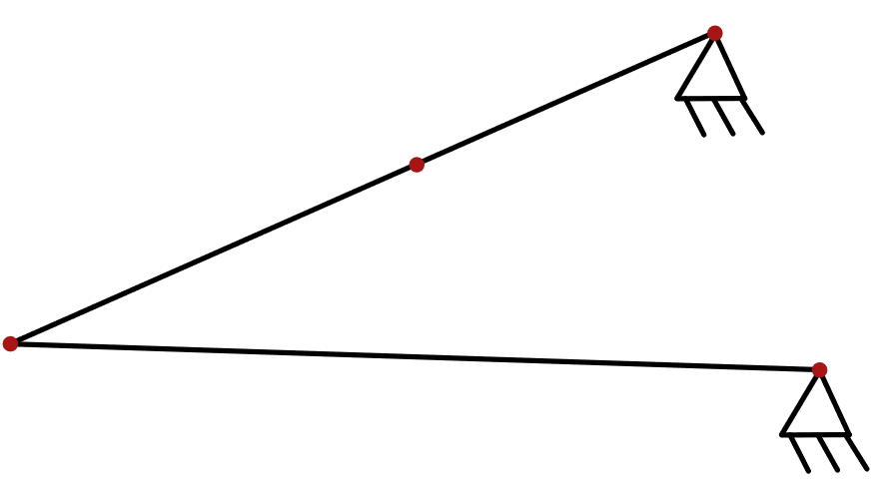
Chassis and Body Design
and Manifacturing M
RIGHT SIDE
FOOTPEG HOLDER
PROJECT 4
for a supersport bike
xB
B
yD'
Constraint reactions
Let's calculate the reactions taking also the external loads due to the constraints of the break leverage.
y_{A} = 844 N
x_{A} = 2.707 N
y_{B} = 156 N
x_{B} = -2.707 N
Mt_{tot}
Fz1
D
xD'
yB
yA
xC'
A
C
xA
yC'
Footpeg Holder
Nodes A and B are the anchoring points of the structure by means of threaded joints, node C is the projection of the footpeg axis (coaxial to the one of the brake lever hinge) and node D is the anchor point of the brake pump to the plate: the structure is iperstatic.
Notes:
Separiamo le strutture adesso

Slide 11
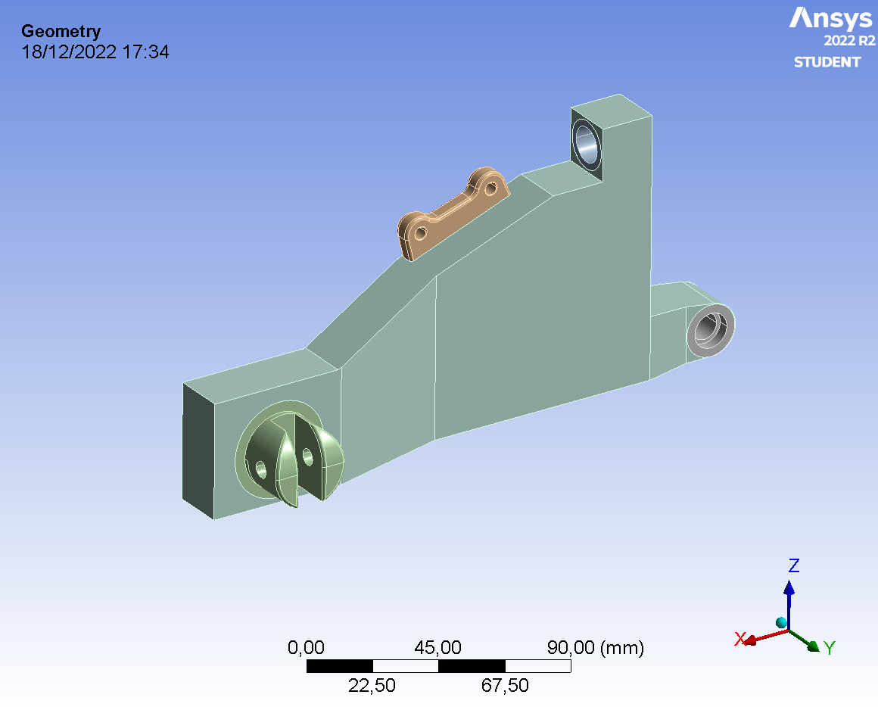
Chassis and Body Design
and Manifacturing M
RIGHT SIDE
FOOTPEG HOLDER
PROJECT 4
for a supersport bike
4
FEM
Validation
3D CAD Model Geometry
To construct the FEM model and validate it, it is necessary to start from a 3D CAD geometry that takes account of
Previous general assumptions
Footpeg assumed as a rigid for displacement calculation;
No permanent deformation allowed upon unloading;
The surplus material needed to make topological optimiser work;
The commercial solution.

Slide 12
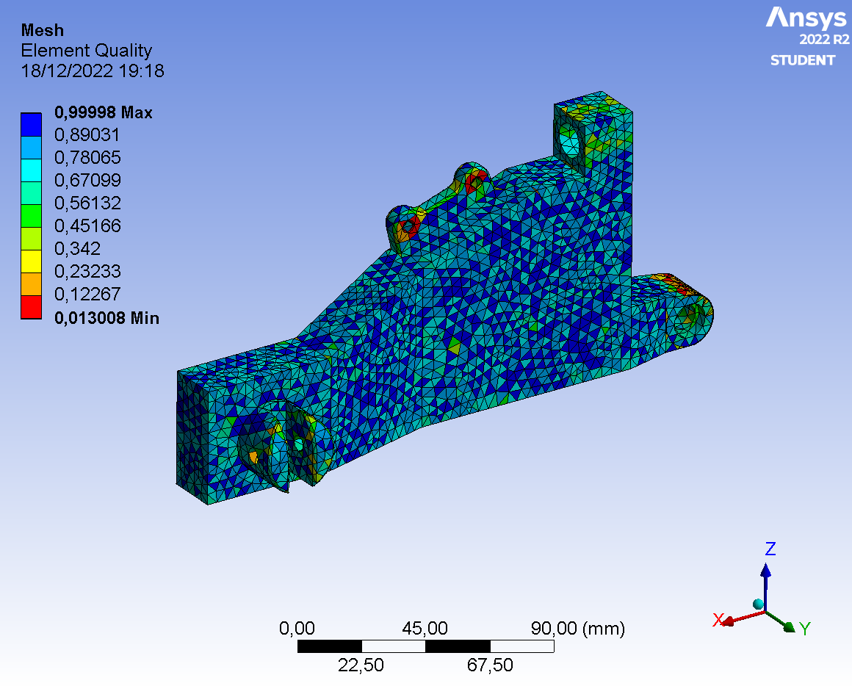
Chassis and Body Design
and Manifacturing M
RIGHT SIDE
FOOTPEG HOLDER
PROJECT 4
for a supersport bike
4
FEM
Validation
ANSYS Static Stractural Set Up
The simulation uses the previous CAD geometry with a minimum mesh size of 4 mm with a growth factor of 1.2 and no capture curvature or proximity features.
Lower Screw modelled as a remote displacement;
Upper Screw modelled as a remote displacement;
Fz1 load applied on a Remote Point set at 15 mm from the tip of the footpeg;
Brake Leverage Hinge reaction modelled as a remote force applied at the hinge surface;
Brake Pump Holder load applied halfway on the two support surfaces through two remote forces.

Slide 13
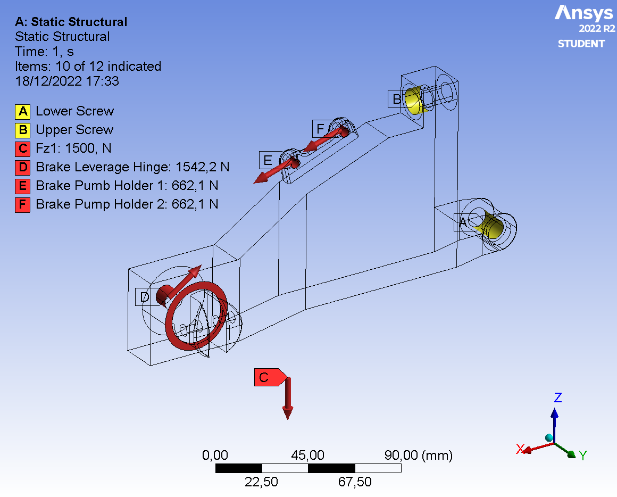
Chassis and Body Design
and Manifacturing M
RIGHT SIDE
FOOTPEG HOLDER
PROJECT 4
for a supersport bike
4
FEM
Validation
ANSYS Static Stractural Set Up
The simulation uses the previous CAD geometry with a minimum mesh size of 4 mm with a growth factor of 1.2 and no capture curvature or proximity features.
Lower Screw modelled as a remote displacement;
Upper Screw modelled as a remote displacement;
Fz1 load applied on a Remote Point set at 15 mm from the tip of the footpeg;
Brake Leverage Hinge reaction modelled as a remote force applied at the hinge surface;
Brake Pump Holder load applied halfway on the two support surfaces through two remote forces.
Notes:
This is a quick overview of forces and constraints applied to our model​

Slide 14
Chassis and Body Design
and Manifacturing M
RIGHT SIDE
FOOTPEG HOLDER
PROJECT 4
for a supersport bike
4
FEM
Validation
Comparison among Analytical and Validation Results
Results |  | Analytical | Warped_REV.wbpj
 |  |  | FEM | E%
Top Screw Reaction [N] | X | 2707 | 2,584.30 | -4.53%
 | Y | - | -1,791.90 | -
 | Z | 156 | 176.10 | 12.88%
Bottom Screw Reaction [N] | X | -2707 | -2,854.30 | 5.44%
 | Y | - | 1,791.90 | -
 | Z | 844 | 823.89 | -2.38%
Footpeg Tip Displacement (Remote Point) [mm] |  | -0.04064 | -0.77299 | 1802.04%
Notes:
Here we have a comparison between Analytical Solution and Numerical one. As you can see, we got a Numerical solution of the same order of magnitude and even closer values than the analytical one, so that we assumed the model validated.​

Slide 15
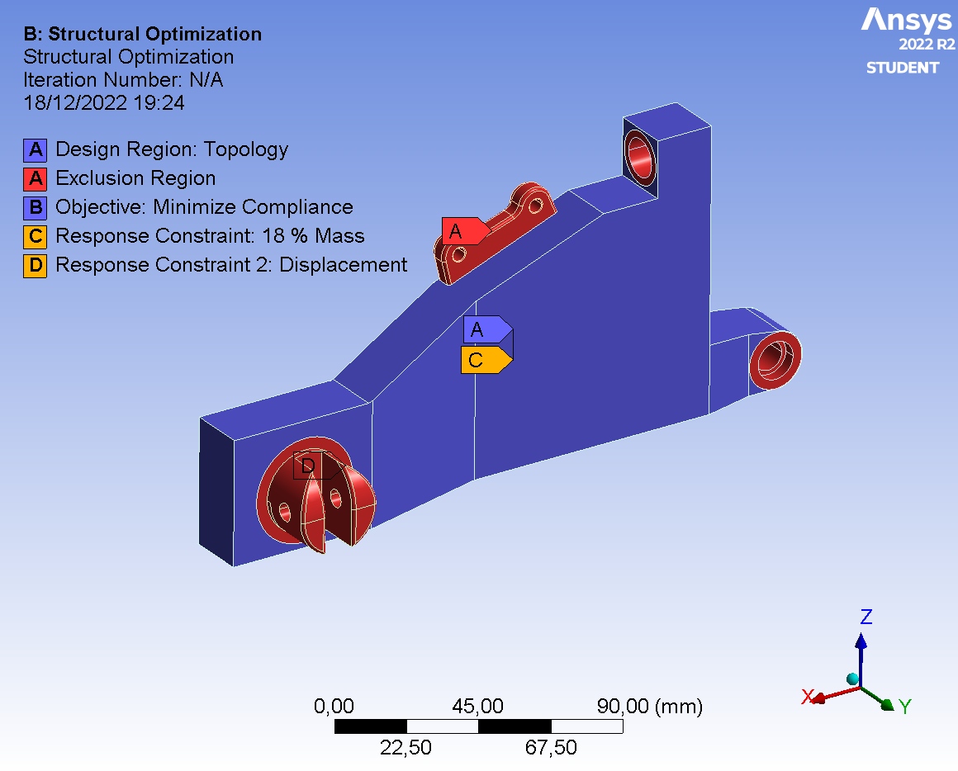
Chassis and Body Design
and Manifacturing M
RIGHT SIDE
FOOTPEG HOLDER
PROJECT 4
for a supersport bike
ANSYS Topological Optimization Set Up
The previous structural simulation results were used as input for topological optimization.
The Design Region include the entire body except the Exclusion Region like the screws holes, the pump support flange and holder’s region of attachment to the footpeg.
The Objective is to minimize the compliance;
The Mass Retainment is set to 18%;
The 2nd constraint of the optimization is set to achieve a remote point's displacement of 8 mm.
5
FEM
Optimization

Slide 16
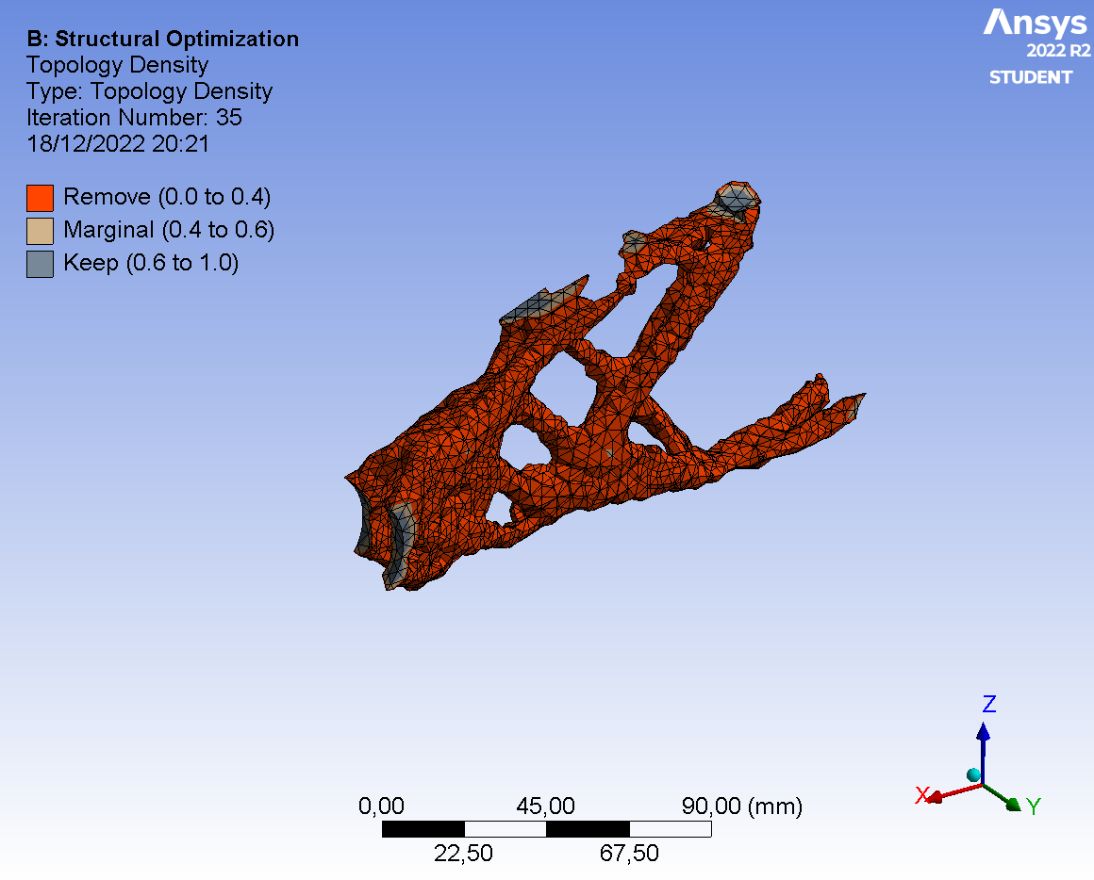
Chassis and Body Design
and Manifacturing M
RIGHT SIDE
FOOTPEG HOLDER
PROJECT 4
for a supersport bike
Topology Density
The output mesh file shows some cut off sub-structures due to the removal of material. In order to get a proper mesh structure, it is required to modify the mass retain threshold to restore part of the material.

Slide 17
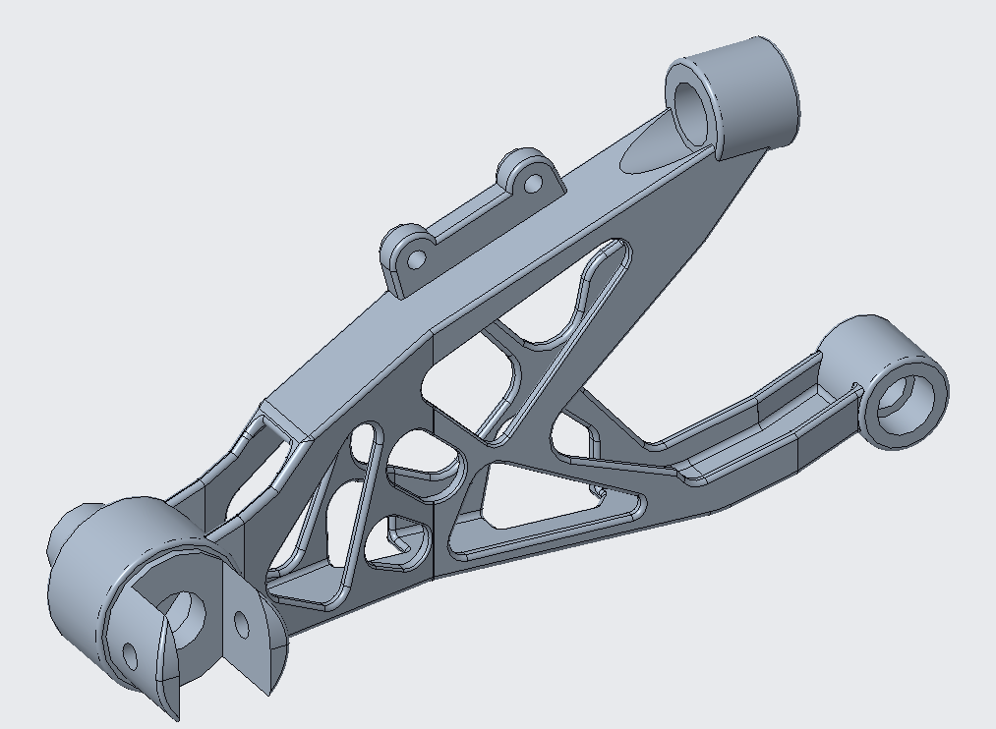
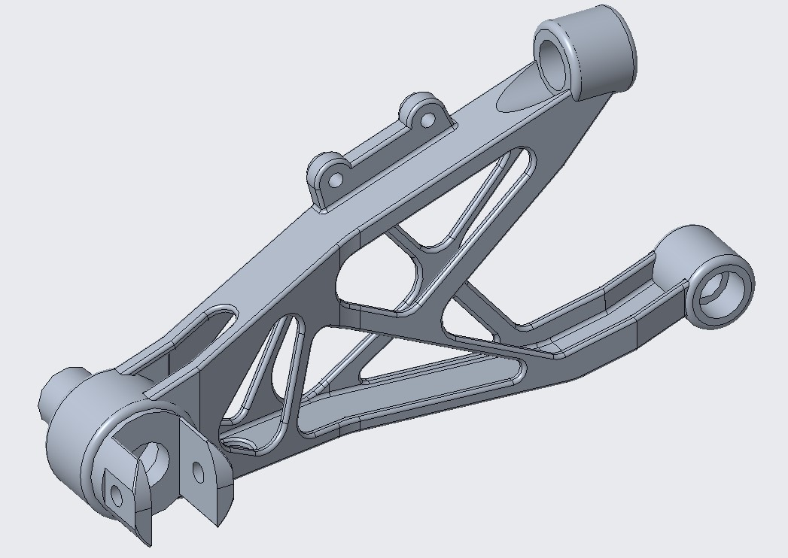
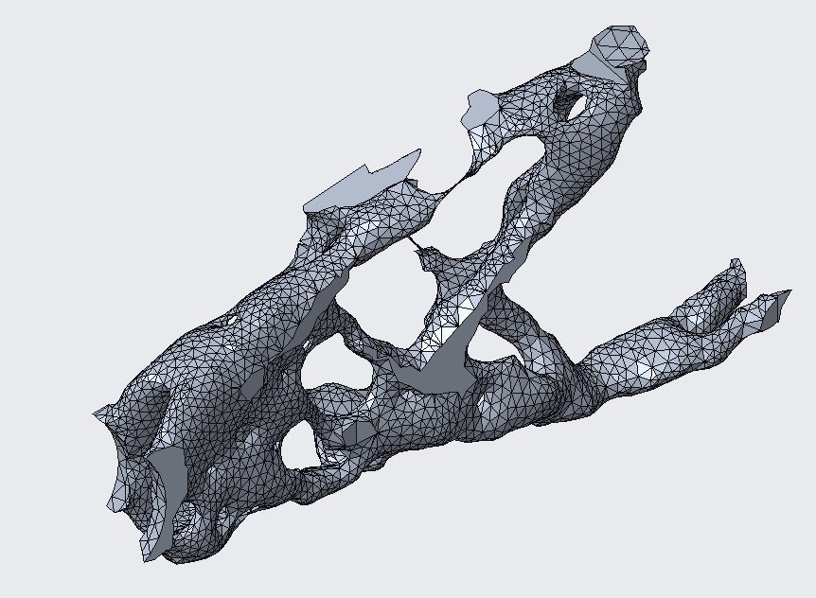
Chassis and Body Design
and Manifacturing M
RIGHT SIDE
FOOTPEG HOLDER
PROJECT 4
for a supersport bike
6
Reverse Engineering
Reverse the Holder by Steps
Optimized Mesh
REV 6
REV 10
Notes:
We made ten different in-series attempts starting from first topological optimization(on your left) to the last static structural analysis(on your right), focusing on reducing Equivalent (Von-Mises) stress and increasing footpeg tip displacement up to –8 mm until we accomplished the requirements given at the beginning.​

Slide 18
Chassis and Body Design
and Manifacturing M
RIGHT SIDE
FOOTPEG HOLDER
PROJECT 4
for a supersport bike
6
Reverse Engineering
Reverse Modelling Iterations
Results |  | Analytical | REV1 | REV2 | REV3 | REV4 | REV5 | REV6 | REV7 | REV8 | REV9 | REV10
Top Screw Reaction | X | 2707 | 1882,4 | 2155,7 | 2174,3 | 2175,6 | 2173,6 | 1918,0 | 2202,5 | 2199,3 | 1925,2 | -2194,9
 | Y | - | -1618 | -1574,2 | -1571,8 | -1558,2 | -1557,7 | -1591,9 | -1543,3 | -1533,2 | -1531,2 | -1530,3
 | Z | 156 | 1026,5 | 1431,1 | 1420,4 | 1426,5 | 1426,8 | 892,6 | 1176,3 | 1173,7 | 1156,7 | 1165,4
Bottom Screw Reaction | X | -2707 | -1882,4 | -2155,7 | -2174,3 | -2175,6 | 2173,7 | 1918 | 2202,5 | 2199,3 | 2185,1 | 2194,9
 | Y | - | 1618 | 1574,2 | 1571,8 | 1558,2 | 1557,7 | -1591,9 | 1534,3 | 1533,2 | 1531,2 | 1530,3
 | Z | 844 | -401,55 | -431,14 | -420,35 | -426,55 | -426,84 | -267,60 | -176,26 | -173,69 | -156,67 | -165,46
Footpeg Tip Displacement |  | -0,04064 | -2,9804 | -3,9468 | -4,2995 | -5,8599 | -6,1697 | -7,3000 | -7,7262 | -7,3982 | -6,7993 | -6,5686
Notes:
We ended up with a footpeg tip displacement of about –6.56 mm.​

Slide 19
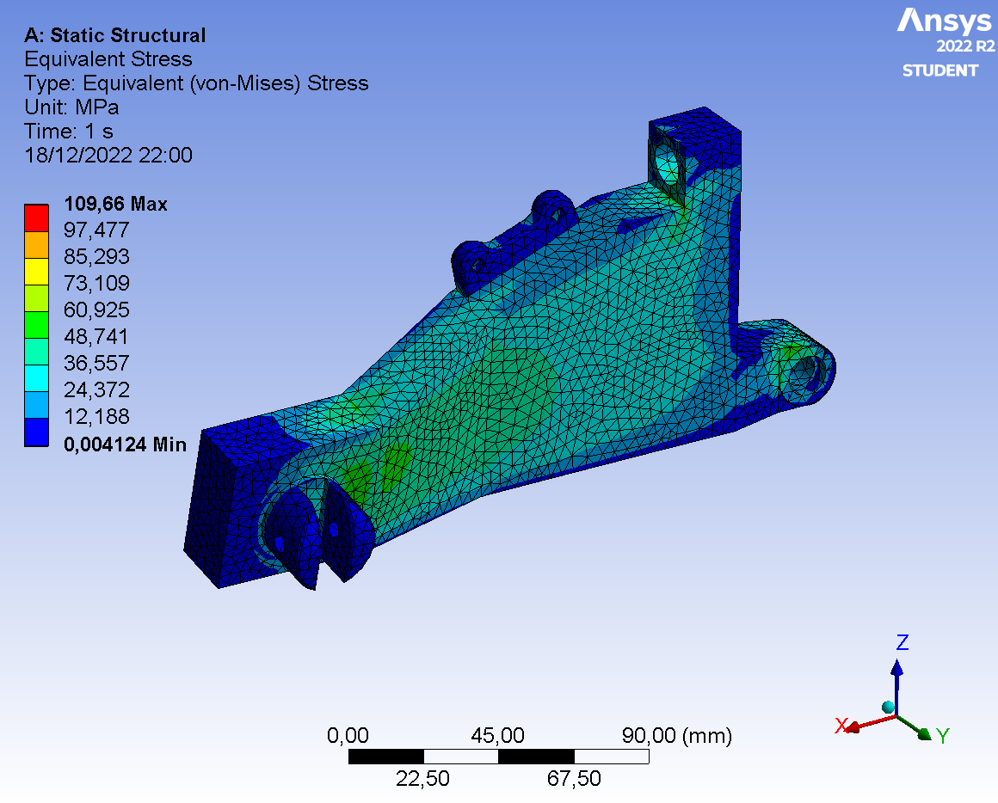
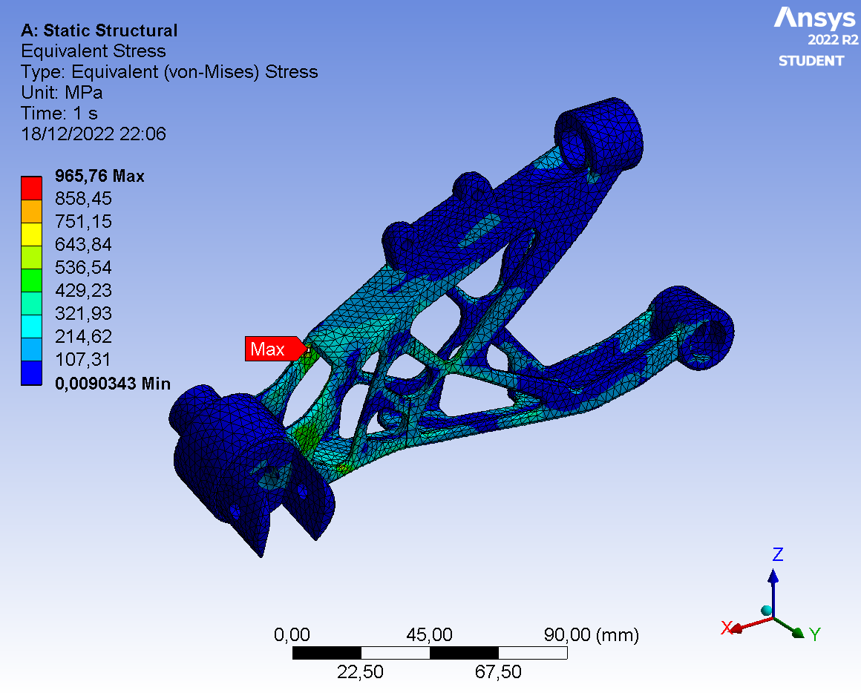
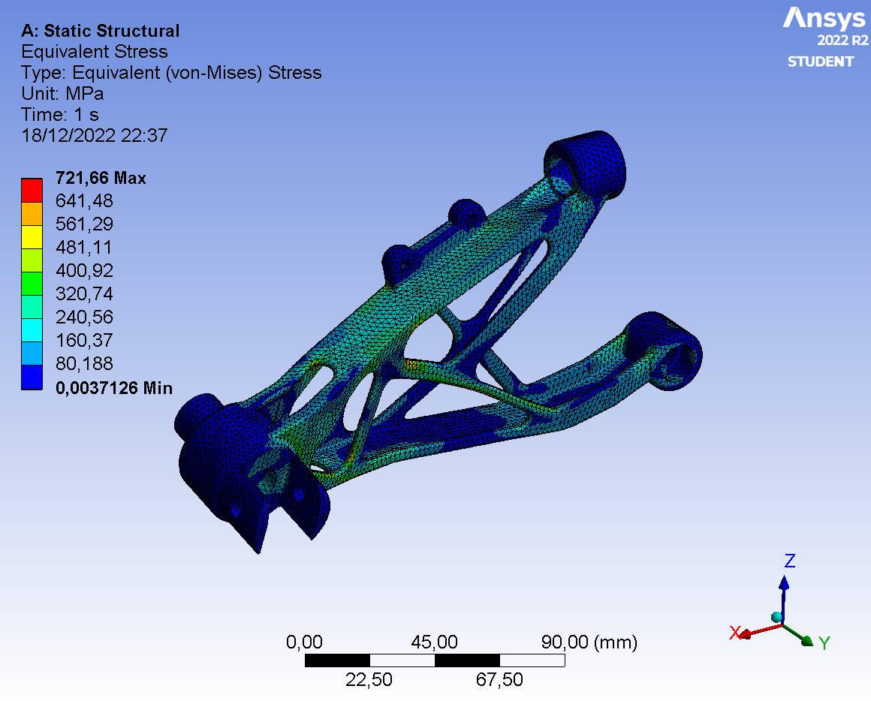
Chassis and Body Design
and Manifacturing M
RIGHT SIDE
FOOTPEG HOLDER
PROJECT 4
for a supersport bike
6
Reverse Engineering
Equivalent Stress Peaks
Optimized Mesh
REV 6
REV 10
Notes:
Here you can see the stresses distribution on the footpeg holder. Although the stress overcome the Yield Strength of material, actually this happens in very small volumes, so that static simulation is not affected by that.​

Slide 20
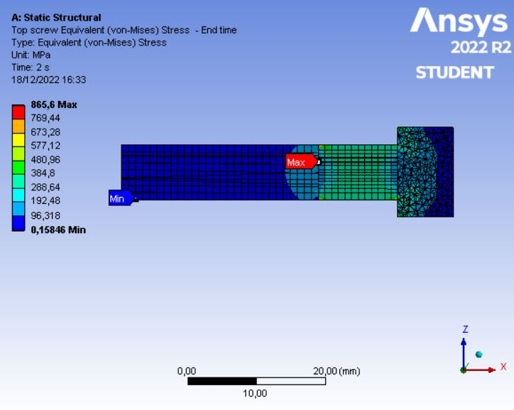
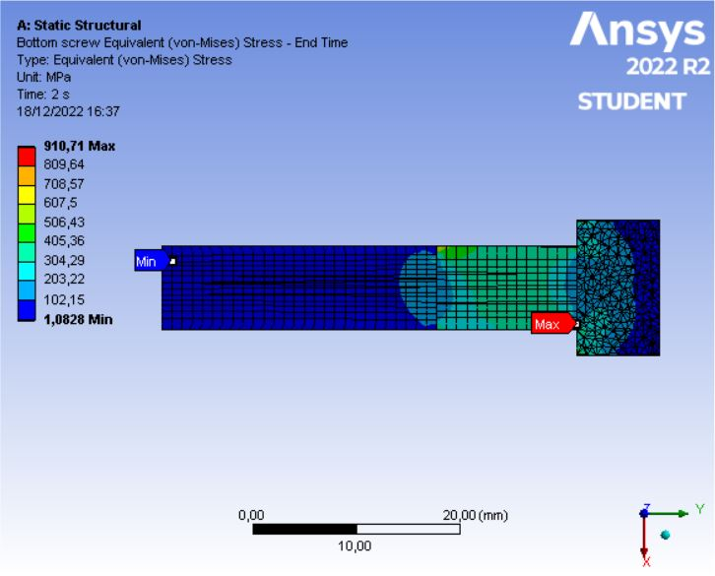
Chassis and Body Design
and Manifacturing M
RIGHT SIDE
FOOTPEG HOLDER
PROJECT 4
for a supersport bike
7
Screws Validation
Right Side Footpeg Holder
To evaluate stresses distribution on them, a section plane cutting each screw into two bodies through their axis was created and, apart from little stress concentration superficial zones, screw design was validated.
Notes:
Finally, we replaced remote displacement constraints from previous static structural analysis with physical screws coupling the footpeg holder with the motorbike frame. Then we performed a multi-step static structural analysis dividing the time interval into two substeps. In the first substep, we applied bolt pretension on screws. In the second substep we applied assignment forces and brake lever reactions on the footpeg holder itself. ​

Slide 21
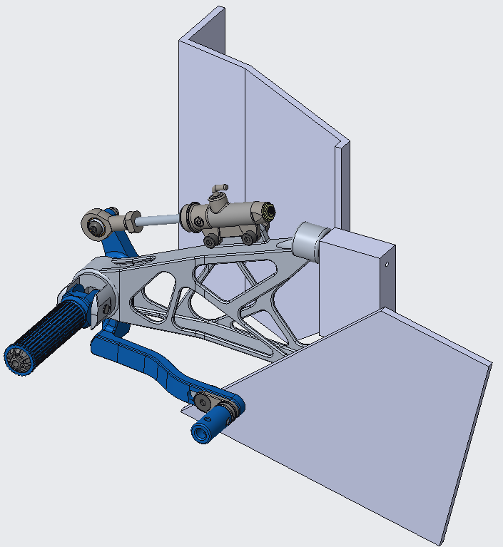
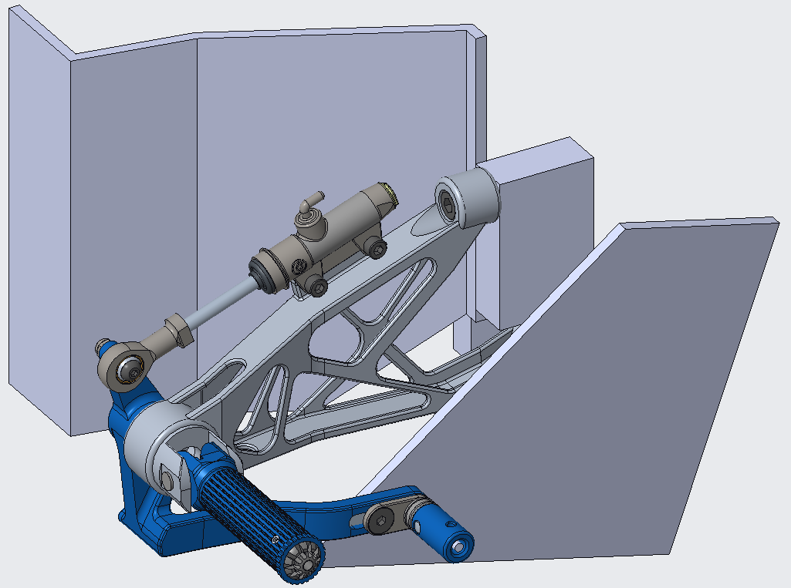
Chassis and Body Design
and Manifacturing M
RIGHT SIDE
FOOTPEG HOLDER
PROJECT 4
for a supersport bike
8
Assembly Review

Slide 22
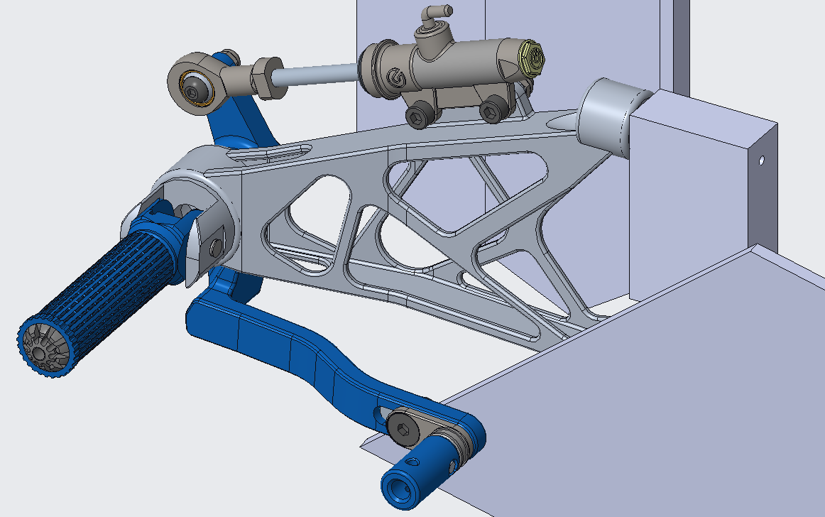
Chassis and Body Design
and Manifacturing M
RIGHT SIDE
FOOTPEG HOLDER
PROJECT 4
for a supersport bike
8
Assembly Review

Slide 23
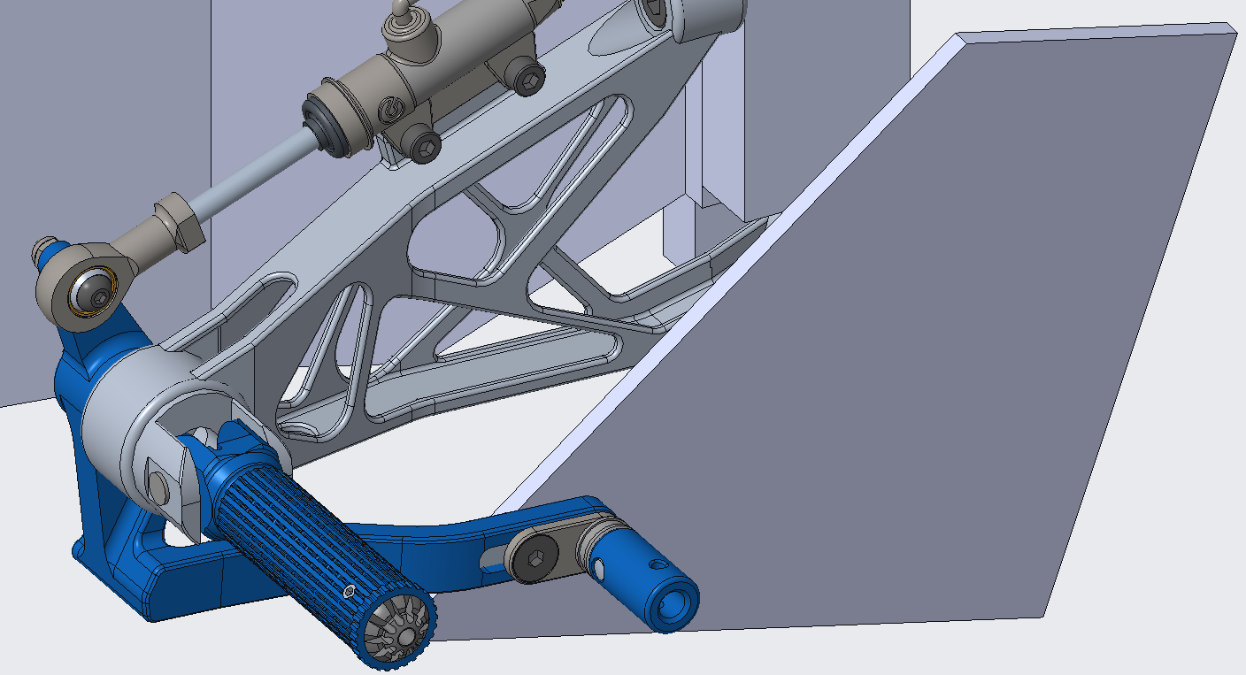
Chassis and Body Design
and Manifacturing M
RIGHT SIDE
FOOTPEG HOLDER
PROJECT 4
for a supersport bike
8
Assembly Review

Slide 24
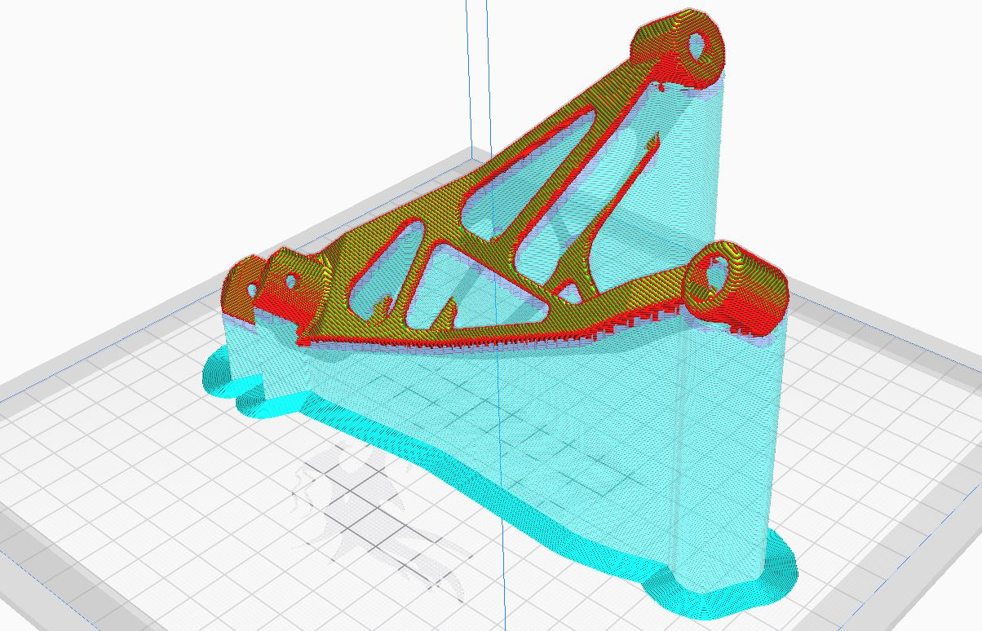
Chassis and Body Design
and Manifacturing M
RIGHT SIDE
FOOTPEG HOLDER
PROJECT 4
for a supersport bike
8
Printing Preview
Printing
Strategies
Once the final CAD model of the component has been obtained, it is possible to study some printing strategies: its particular warped shape makes it necessary to prepare the body with a certain inclination with respect to the printing plane, in order to correctly construct the piece and the supporting infrastructure.

